Slide 1
Roswell CITY COUNCIL MEETING
December 11, 2017

Slide 2
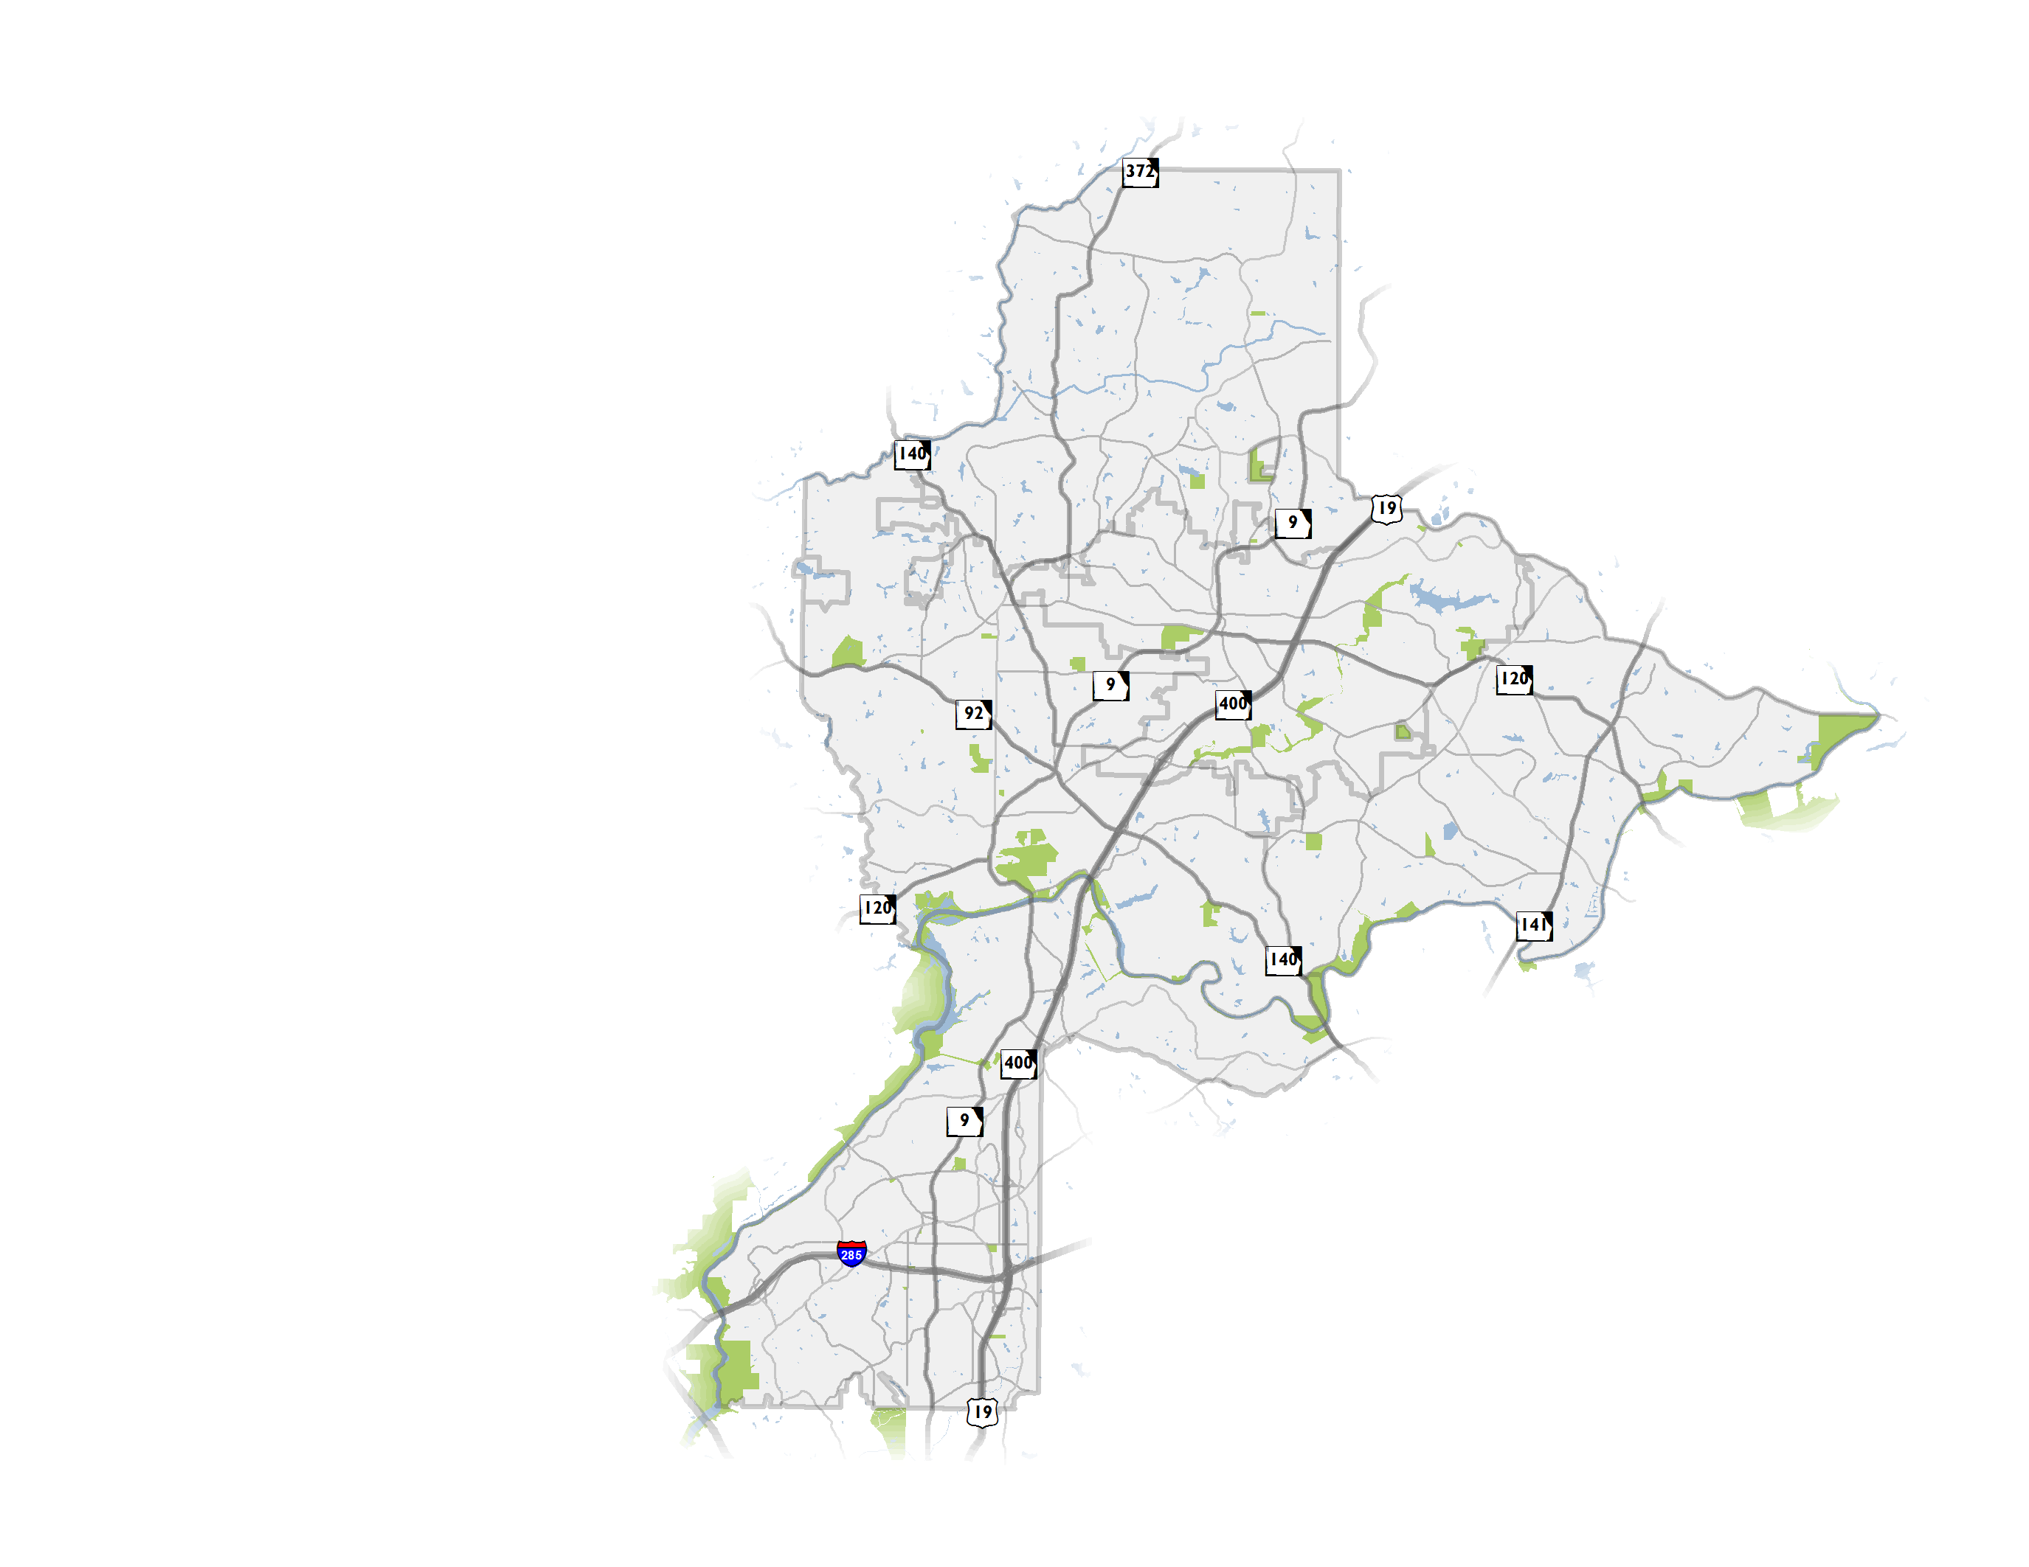
NFCTP Update
Update to initial 2010 Plan
Partnership of 6 North Fulton Cities and the Atlanta Regional Commission (ARC)
Establishment of a vision for transportation
Both local and regional projects, transportation policies
2

Slide 3
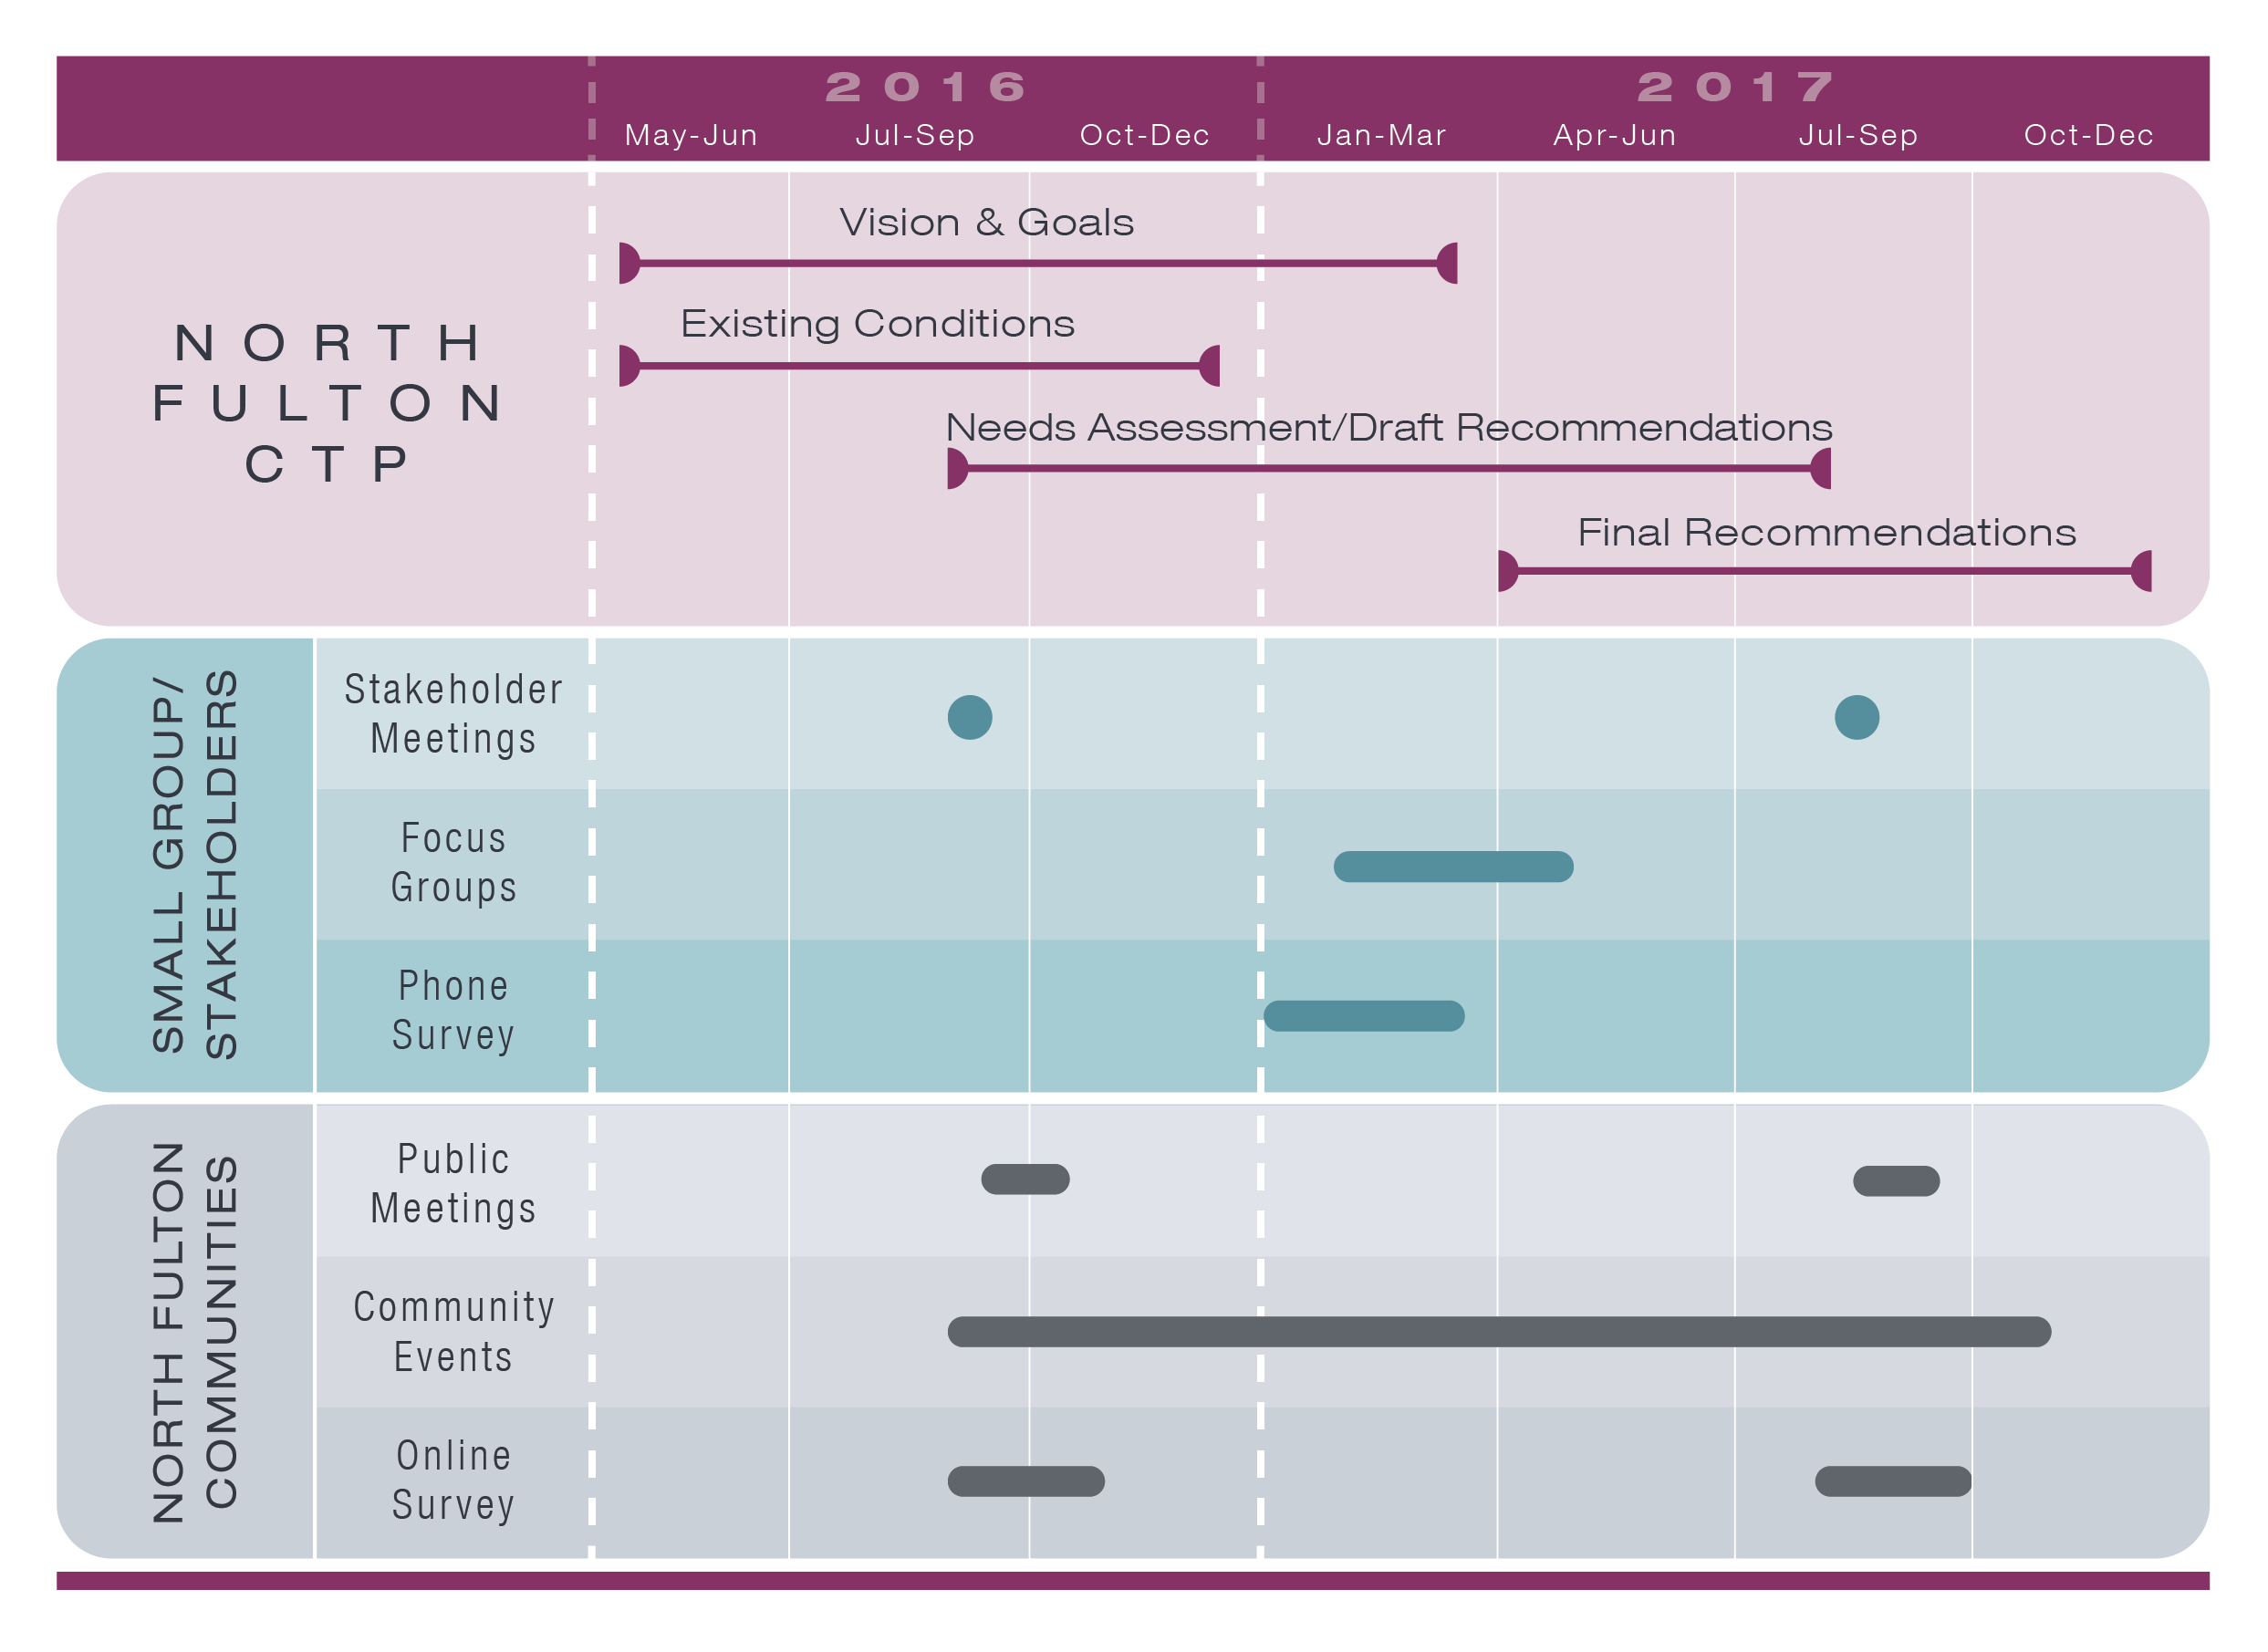
Planning Process
Roswell public meetings were held on September 27, 2016 and August 22, 2017.
3

Slide 4
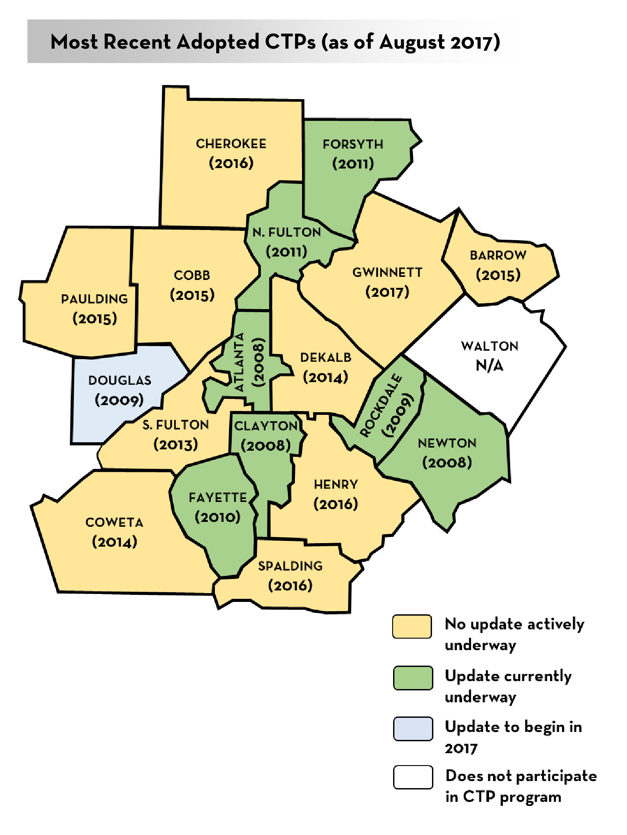
The CTP Program
Atlanta Region’s Plan is informed primarily by CTPs
ARC provides financial assistance to counties (80:20 split)
CTPs help the region to fill federally required plan elements indicated in Code of Federal Regulations*
Participation not required but is an accepted practice across metro Atlanta (18 CTPs currently inform the RTP)
*(CFR; Title 23 CFR 450.306; CFR 450.322)
4

Slide 5
Leveraging the CTP for additional funding
Other federal funding programs
Infrastructure For Rebuilding America (INFRA) grants
Federal Lands Access Program (FLAP) grants
Other state funding programs
Georgia Transportation Infrastructure Bank (GTIB) grants
New ARC calls for projects (regional)
LCI implementation, CMAQ
Other TIP funding categories
Private/Quasi-private partnerships
Community Improvement District funds
Private institution/organization collaboration
5

Slide 6
Project Universe for Roswell
Projects considered came from a variety of sources
NFCTP 2017 assesses the project universe and vets the need for projects identified in previous efforts and searches for projects to “get in the queue”
Final recommendations list includes:
260 new NFCTP 2017 projects considered, 34 included in Roswell’s recommended list
Project feasibility and public appetite
Project consolidation (e.g., consolidate bicycle/pedestrian recommendation with roadway improvement)
6

Slide 7
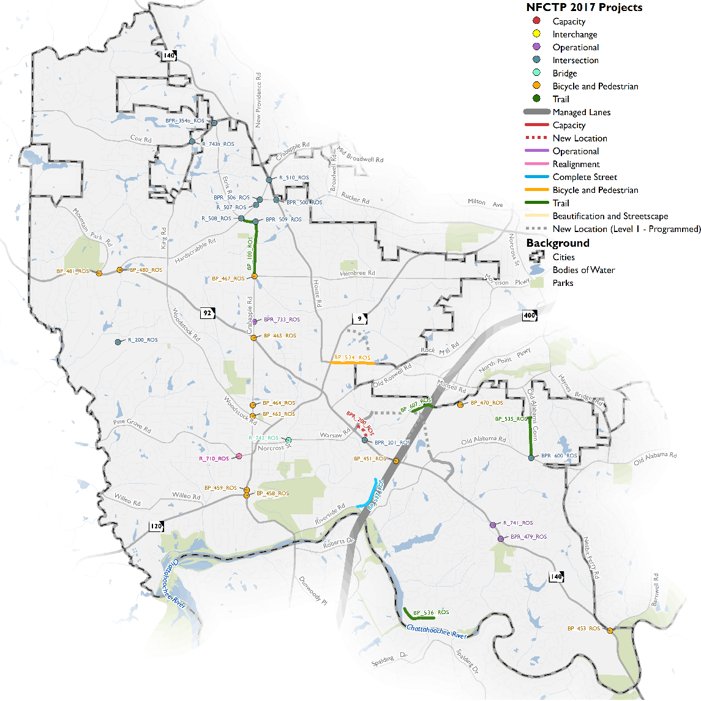
New Projects – Active Transportation
GA 400 at Holcomb Bridge Road
Holcomb Bridge Road at Barnwell Road
Marietta Highway at South Atlanta Street
North Atlanta Street at Park Square
Canton Street at Woodstock Road
Canton Street at Minhinette Drive
Crabapple Road at East Crossville Road
Crabapple Road at Hembree Road
Future Big Creek Greenway Trailhead at Trail Entrance
Future Foe Killer Creek Trailhead at Trail Entrance
Hardscrabble Road at Woodstock Road
Bowen Road at Old Mountain Park Road
Mansell Road Sidepaths
Dogwood Road Complete Streets
Etris Road/Crabapple Road Multi-use Trail
Old Alabama Connector Multi-use Path
Riverside Drive Multi-use Path
Big Creek Trail Phase 4
7
Notes:
Atlanta Region’s Plan (RTP), 2010 NFCTP, Roswell Transportation Master Plan (2014), other studies

Slide 8
New Projects – Roadway
Old Alabama Road at Old Alabama Road Connector
Holcomb Bridge Road at Riverwood Lane
Etris Road at Cox Road
Rucker Road at Houze Road
Crabapple Road at Rucker Road
Etris Road at Crabapple Road
Jones Road at Bowen Road
Hardscrabble Road at Crabapple Road
Hardscrabble Road at Etris Road
Crabapple Road at Houze Road
Roundabout at Cox Road and King Road
Old Holcomb Bridge Road New Alignment
Holcomb Bridge Road at Eves Road
Crabapple Road at Houze Way
Holcomb Bridge Road at Scott Road
Magnolia Street at Thomas Street Realignment
8
Notes:
Atlanta Region’s Plan (RTP), 2010 NFCTP, Roswell Transportation Master Plan (2014), other studies

Slide 9
North Fulton – project types by City
*MMIP Projects = $16.5 Billion
9

Slide 10
Roswell – Level 1
10

Slide 11
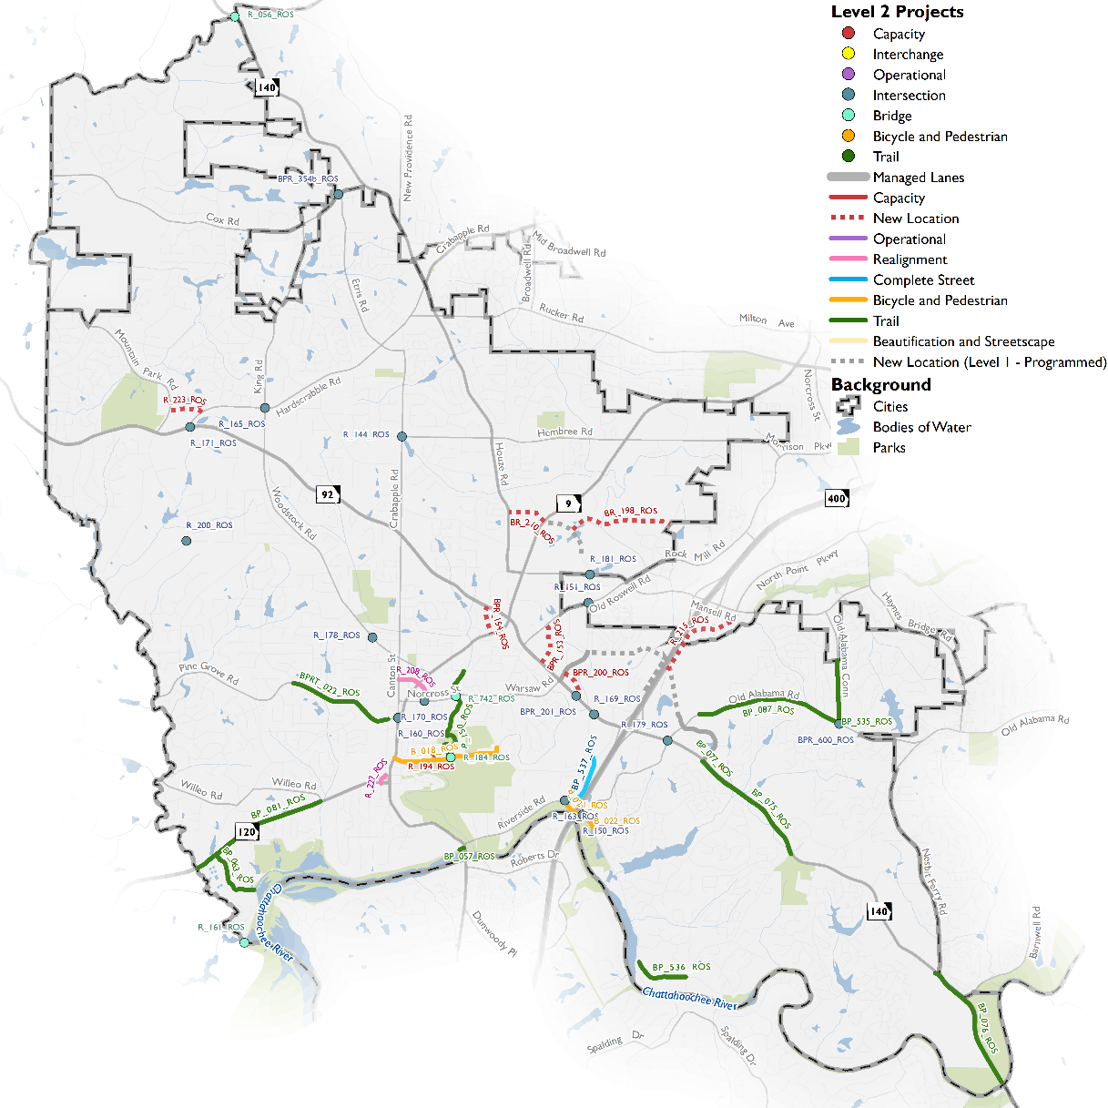
Roswell – Level 2 Key Projects
Key Projects:
Mansell Extension
Commerce Pkwy Extension
Sun Valley Drive - Phases 2 & 3
Big Creek Pkwy – Phase 3
Key Additions include:
Old Alabama Road at Old Alabama Road Connector Intersection Improvements
11

Slide 12
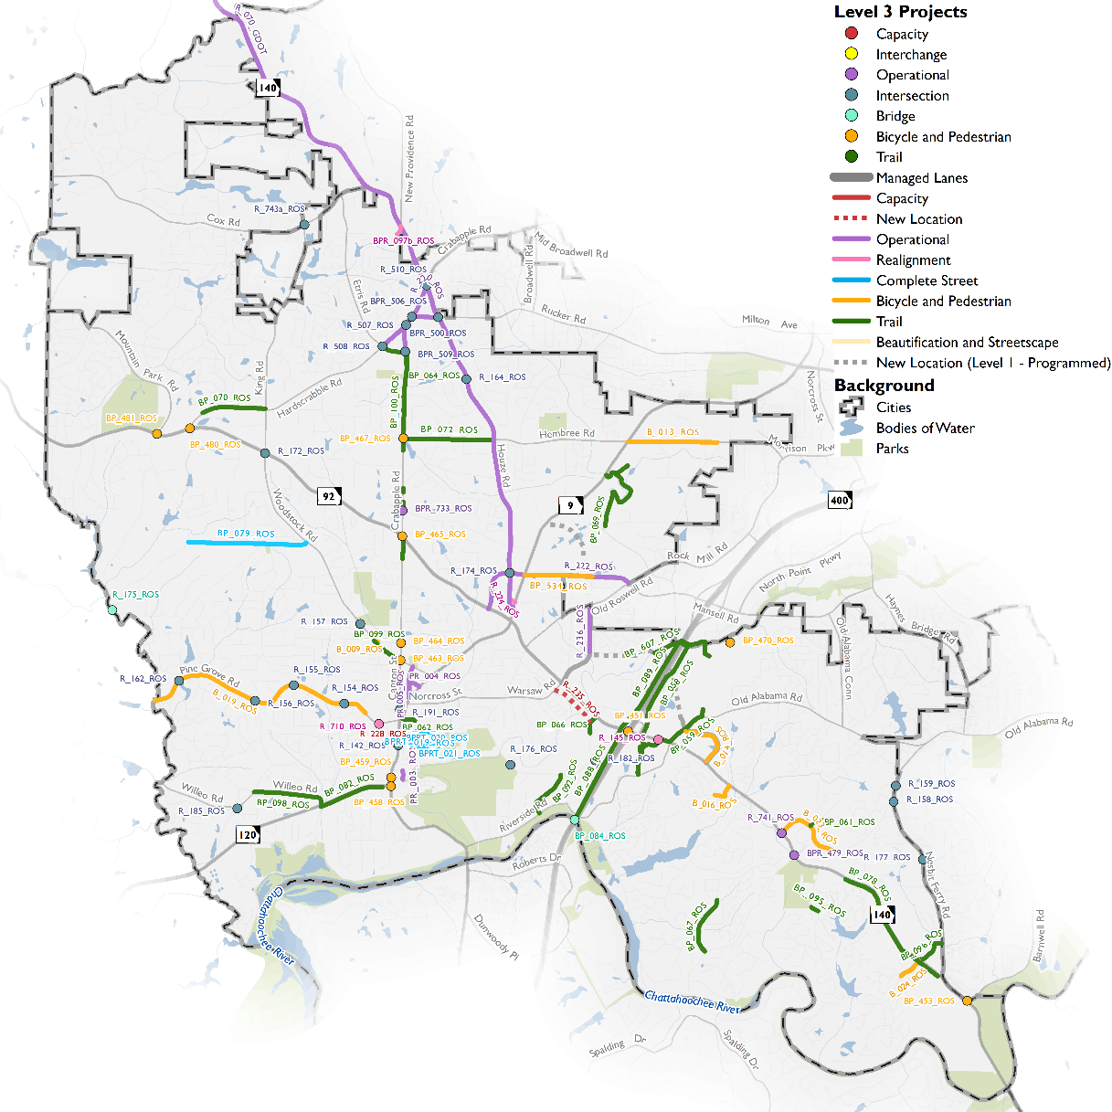
Roswell – Level 3 Projects
Key Projects:
Trails on HBR East Side
Hardscrabble Trail Extension
Cox Rd @ King Rd Intersection
Key Additions include:
Big Creek Trail Phase 4
12

Slide 13
Next Steps
Adoption by North Fulton Cities
Monitor Fulton County Transit Study
As needed, Revisit NFCTP in early 2018
13

Slide 14
Roswell CITY COUNCIL MEETING
December 11, 2017

