Slide 1
MILTON CITY COUNCIL MEETING
February 21, 2018

Slide 2
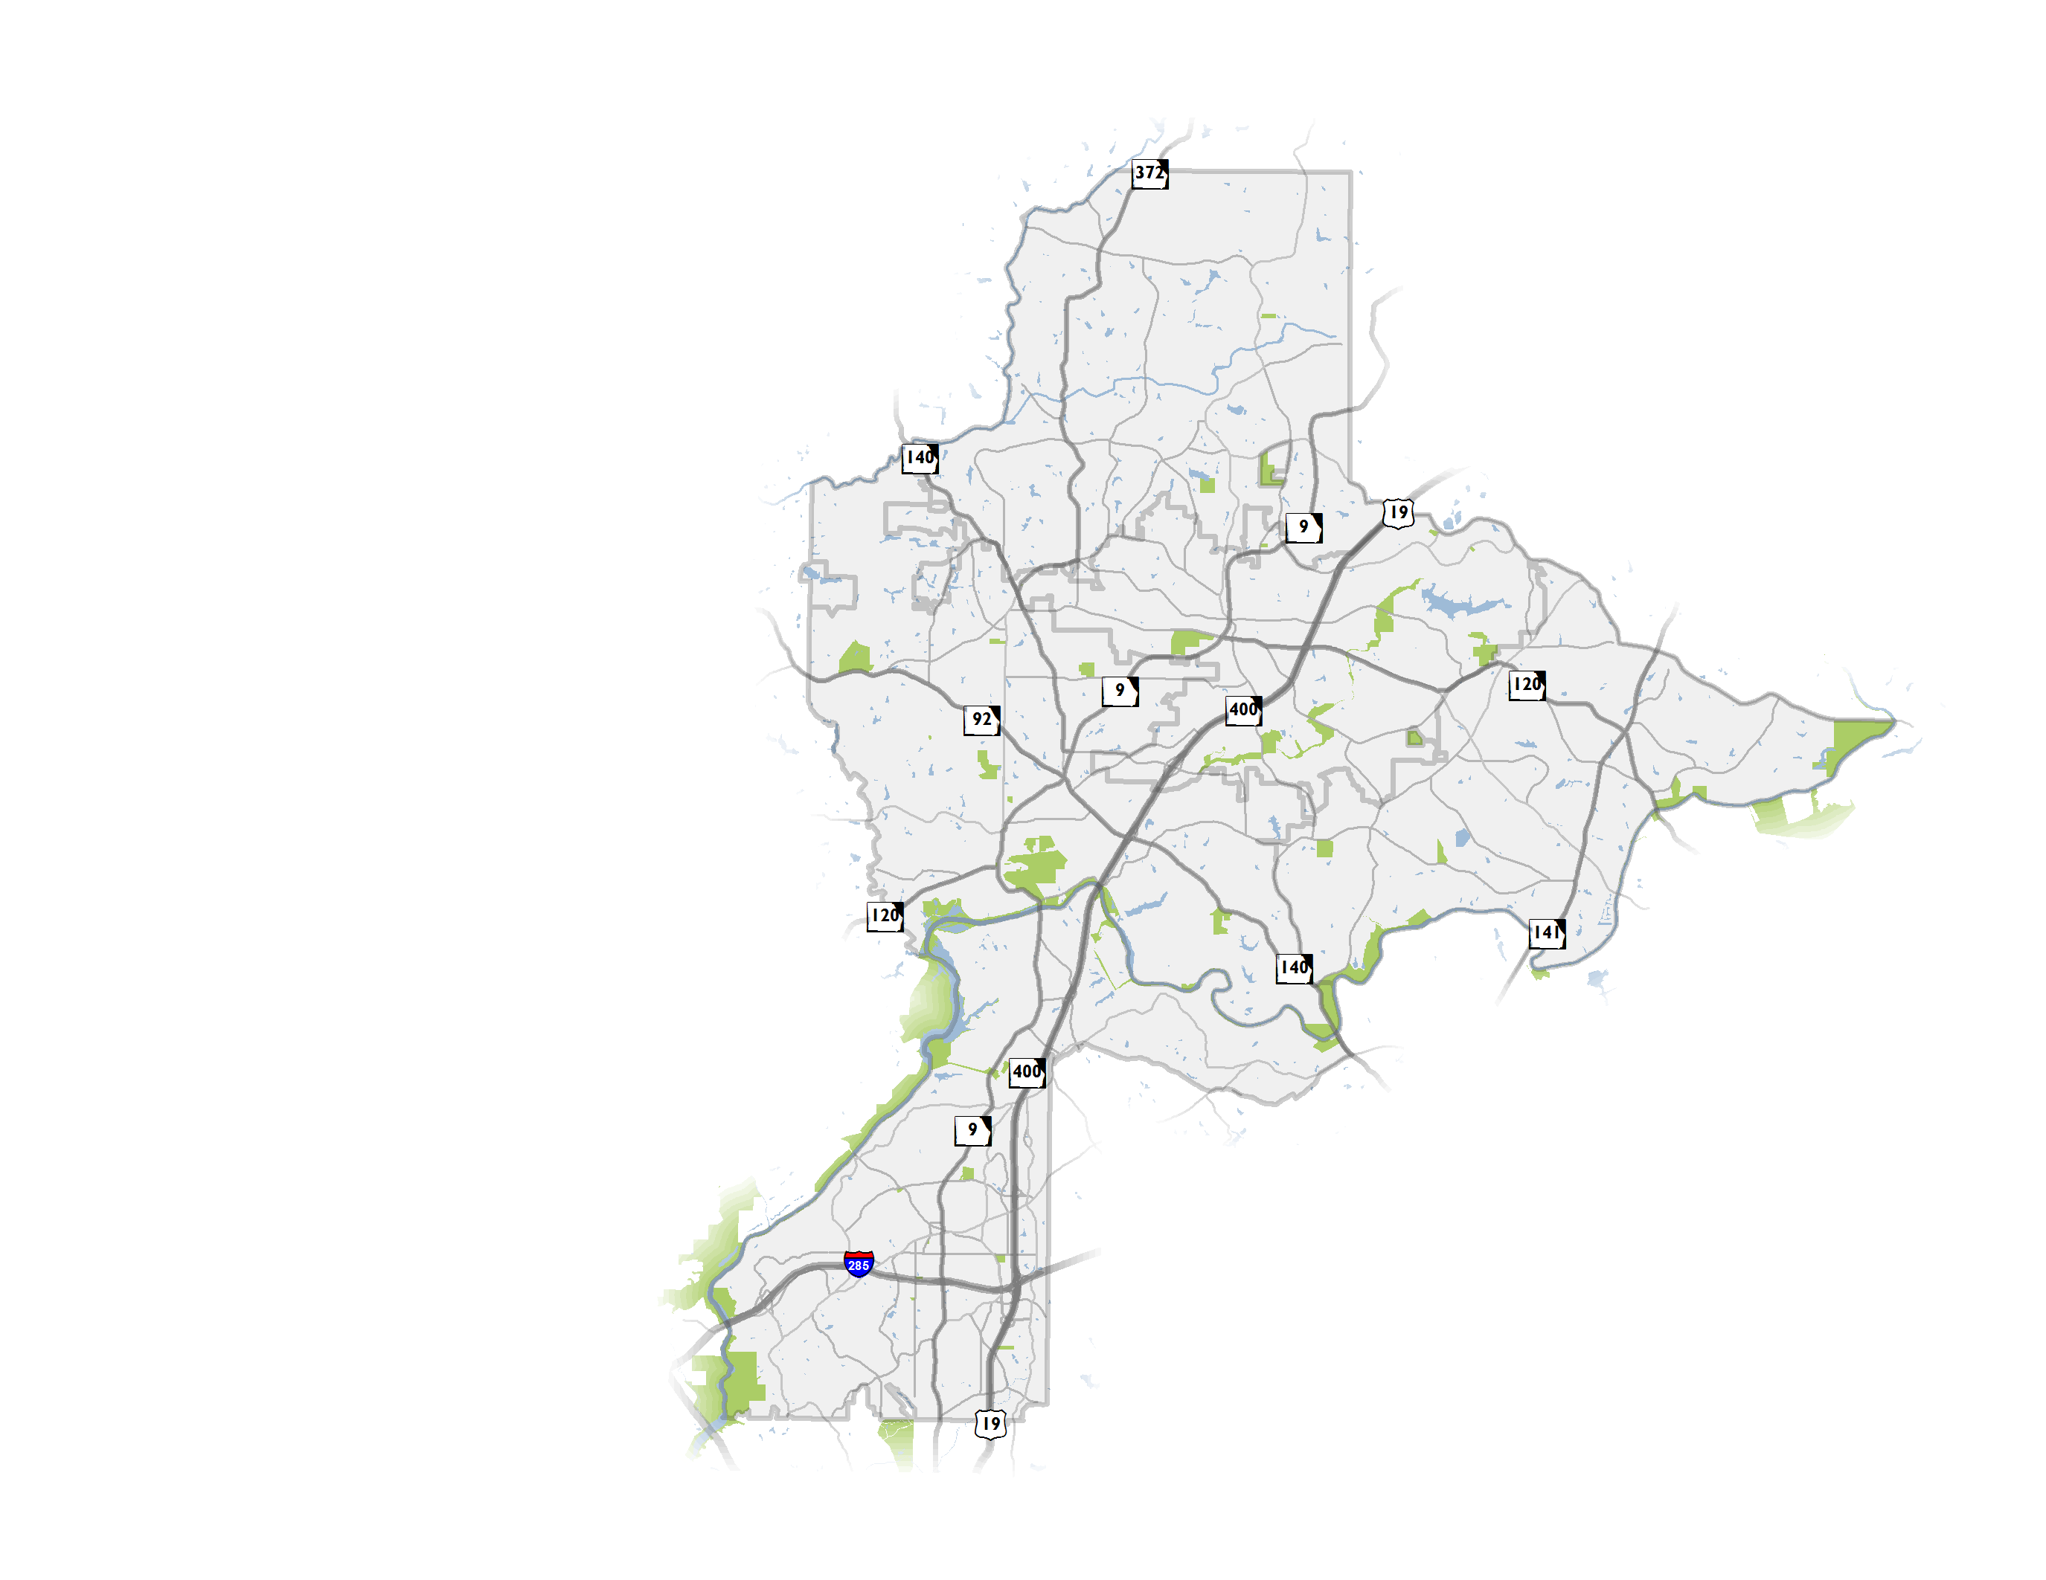
NFCTP Update
Update to initial 2010 Plan
Partnership of 6 North Fulton Cities and the Atlanta Regional Commission (ARC)
Establishment of a vision for transportation
Both local and regional projects, transportation policies
2

Slide 3
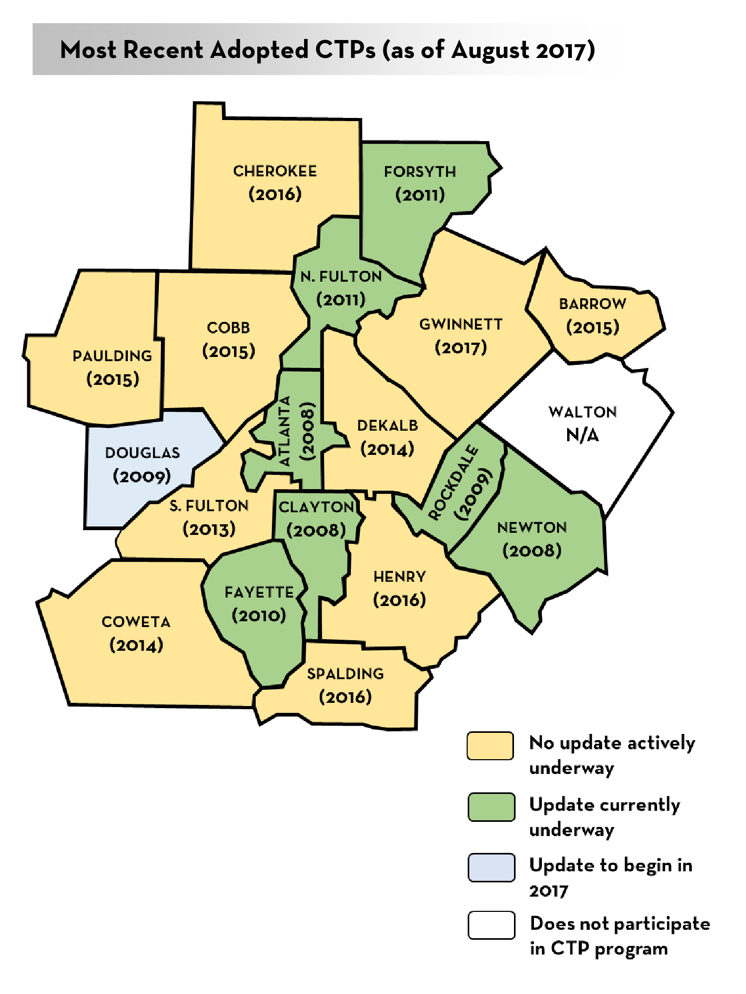
The CTP Program
Atlanta Region’s Plan is informed primarily by CTPs
ARC provides financial assistance to counties (80:20 split)
CTPs help the region to fill federally required plan elements indicated in Code of Federal Regulations*
Participation not required but is an accepted practice across metro Atlanta (18 CTPs currently inform the RTP)
*(CFR; Title 23 CFR 450.306; CFR 450.322)
3

Slide 4
Leveraging the CTP for additional funding
Other federal funding programs
Infrastructure For Rebuilding America (INFRA) grants
Federal Lands Access Program (FLAP) grants
Other state funding programs
Georgia Transportation Infrastructure Bank (GTIB) grants
New ARC calls for projects (regional)
LCI implementation, CMAQ
Other TIP funding categories
Private/Quasi-private partnerships
Community Improvement District funds
Private institution/organization collaboration
4

Slide 5
Fulton County Transit Master Plan
Plan resulted in a market-based vision and four scenarios based on various funding levels for high-capacity transit
On January 29, 2018, Fulton County Commission and Mayors reached general consensus on:
BRT/ART scenario is an actionable starting point
Leave open the potential for future rail extensions
The transit scenarios depend on changes in transit governance and funding at a state and local level
Notes:
Rail extensions considered – GA 400, I-285, South Fulton Parkway, I-20 West, South line to Clayton County (through Hapeville)

Slide 6
Project Universe for Milton
Projects considered came from a variety of sources
Project feasibility and public appetite
Project consolidation (e.g., consolidate bicycle/pedestrian recommendation with roadway improvement)
NFCTP 2018 assesses the project universe and vets the need for projects identified in previous efforts and searches for projects to “get in the queue”
260 new NFCTP 2018 projects considered, 21 included in Milton’s recommended list
6
Notes:
Mention Milton CTP

Slide 7
North Fulton – project types by City
*Does not include Major Mobility Investment Program (MMIP) Projects = $16.5 Billion
7

Slide 8
Milton – Level 1
Projects | City Cost* (in millions)
Capacity | $6.0
New Location | $7.0
Operational | $5.6
Intersection | $18.4
Bicycle and Pedestrian | $5.5
Project Cost Total | $42.5
*Projects that are sponsored by regional and/or statewide agencies are not shown on this map because City is not a direct sponsor.
8

Slide 9
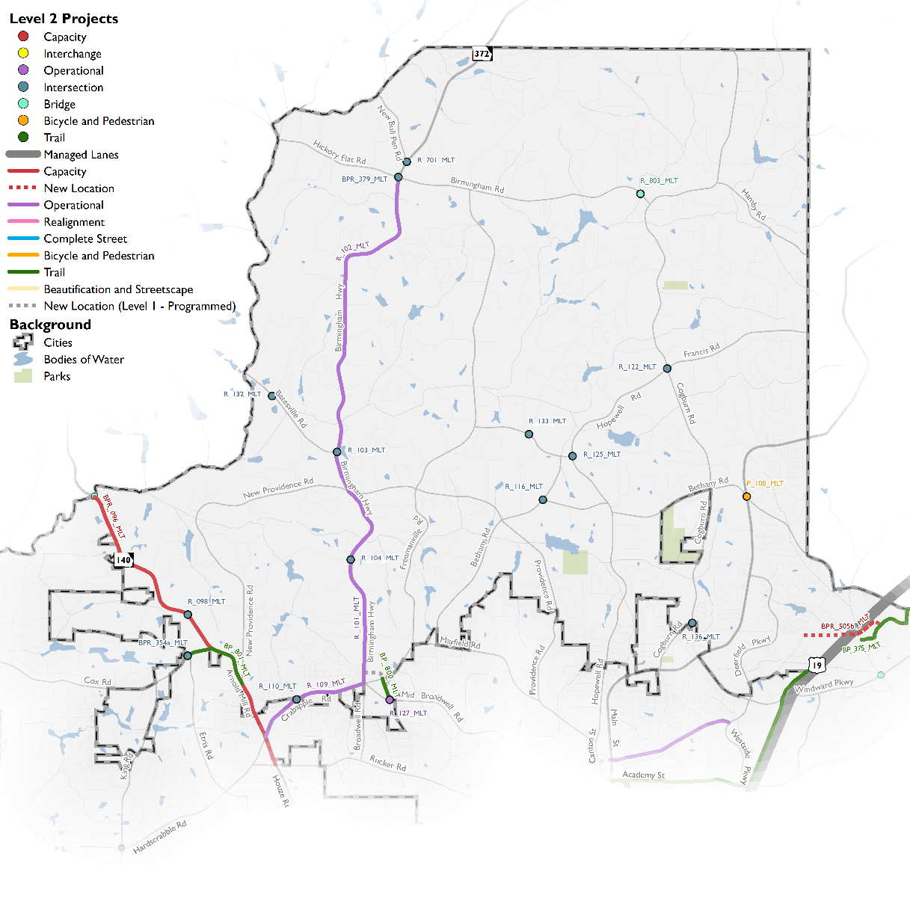
Milton – Level 2
Projects | City Cost (in millions)
New Location | $2.7
Operational | $6.4
Intersection | $3.5
Bicycle and Pedestrian | $2.0
Trail | $4.0
Project Cost Total | $18.6
Programs | City Cost (in millions)
Sidewalks | $5.0
Median, Landscaping, Lighting | $2.0
Traffic Calming | $0.5
Trail Plan Implementation | $6.0
Programmed Funding Total | $13.5
9

Slide 10
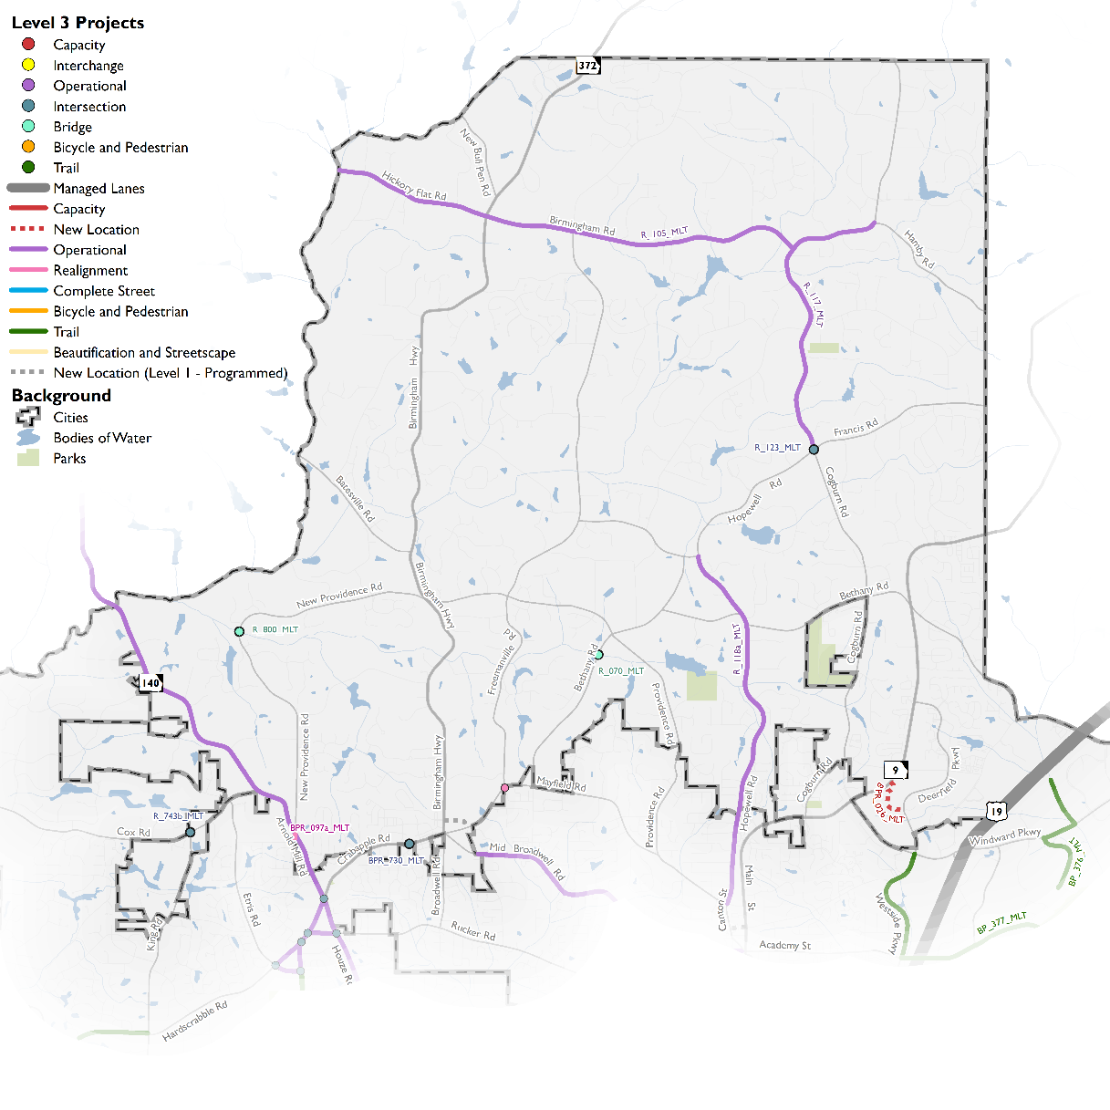
Milton – Level 3
Projects | City Cost (in millions)
Operational | $13.2
Intersection | $1.5
Realignment | $1.4
Trail | $7.7
Project Cost Total | $23.8
Programs | City Cost (in millions)
Sidewalks | $5.0
Median, Landscaping, Lighting | $2.0
Traffic Calming | $0.5
Programmed Funding Total | $7.5
10

Slide 11
Next Steps
Adoption by North Fulton Cities
Milton – February 21
Mountain Park – February 26
Alpharetta – March 5 (Work Session), Council Meeting March/early April
Johns Creek – February 26 (Work Session), Council Meeting March TBD
Roswell – adopted in 2017
Sandy Springs – adopted on February 20, 2018
11

Slide 12
MILTON CITY COUNCIL MEETING
February 21, 2018

