Slide 1
Mountain Park CITY COUNCIL MEETING
February 26, 2018

Slide 2
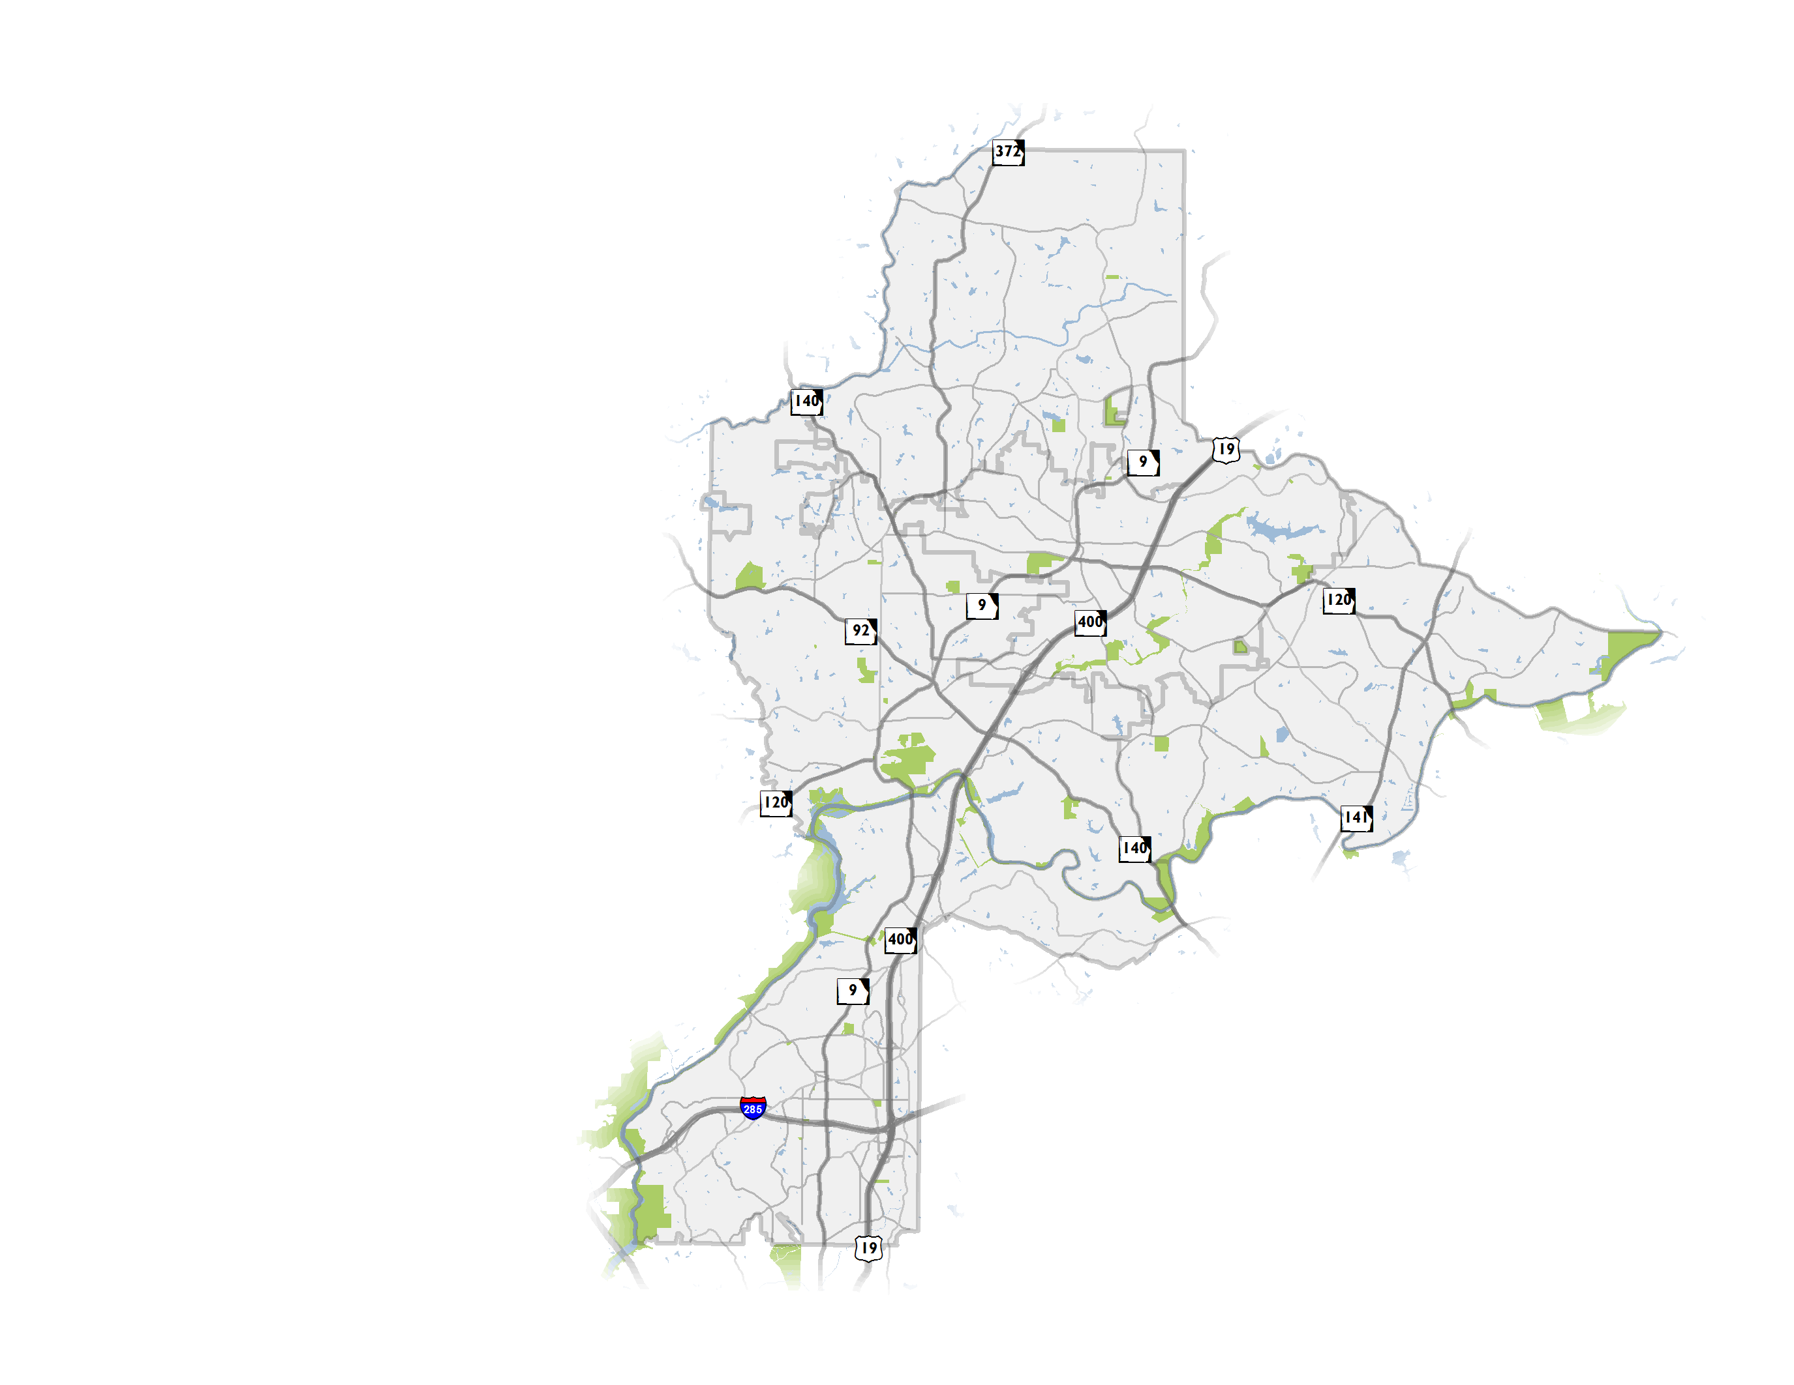
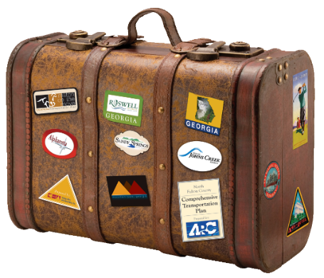
NFCTP Update
Update to initial 2010 Plan
Partnership of 6 North Fulton Cities and the Atlanta Regional Commission (ARC)
Establishment of a vision for transportation
Both local and regional projects, transportation policies
2

Slide 3
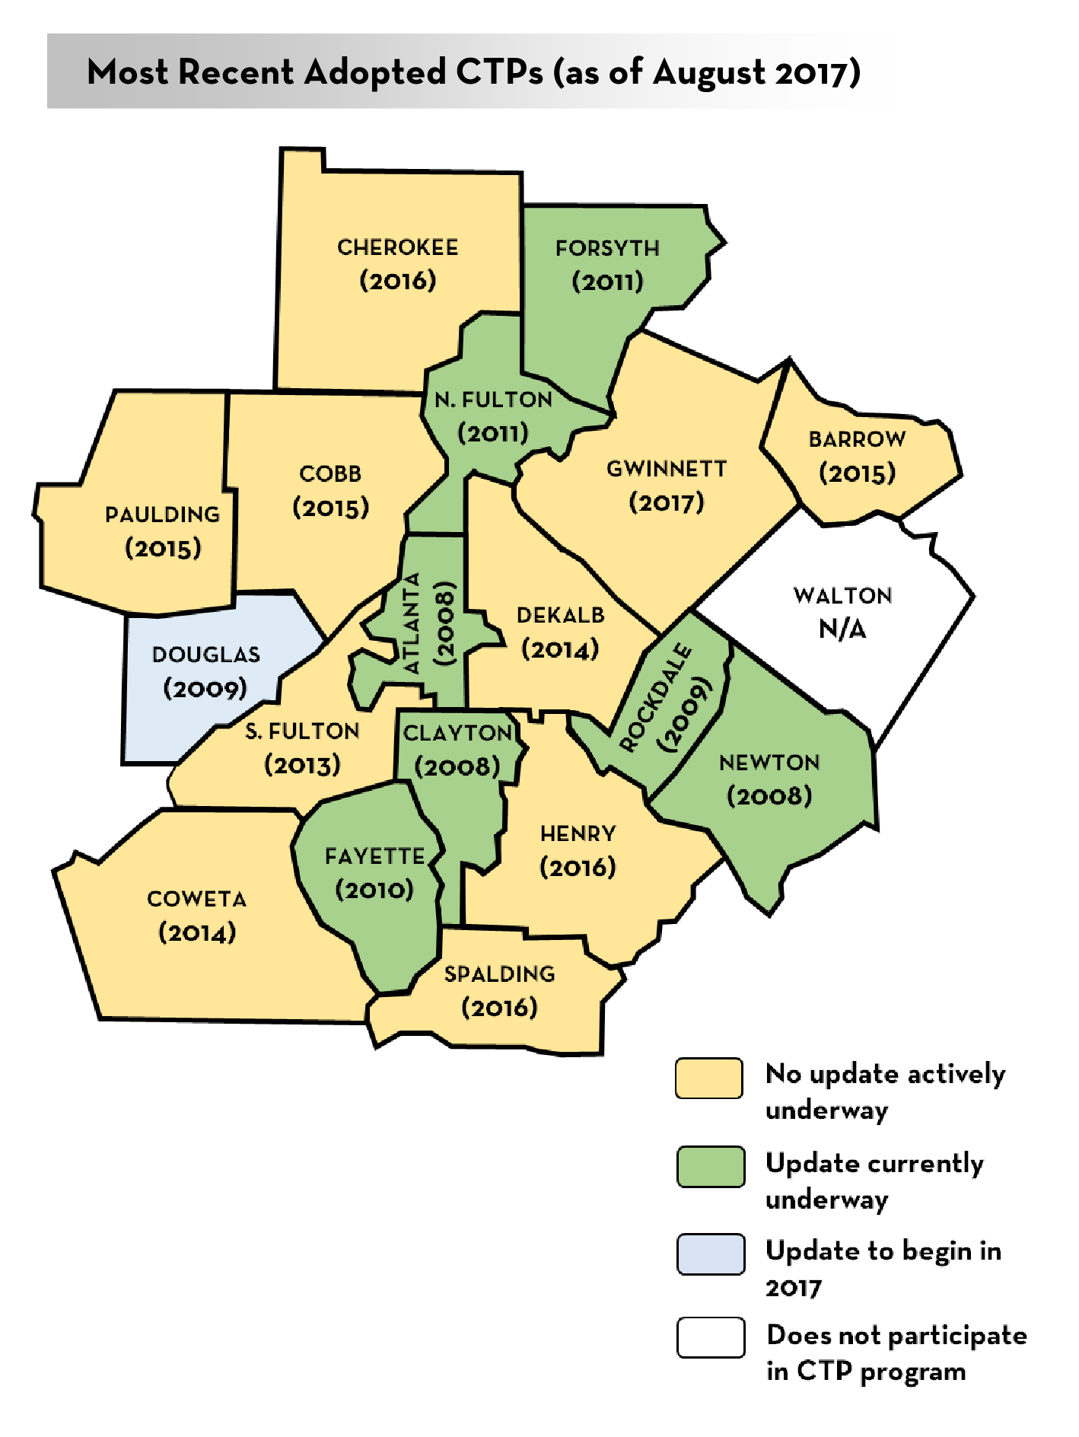
The CTP Program
Atlanta Region’s Plan is informed primarily by CTPs
ARC provides financial assistance to counties (80:20 split)
CTPs help the region to fill federally required plan elements indicated in Code of Federal Regulations*
Participation not required but is an accepted practice across metro Atlanta (18 CTPs currently inform the RTP)
*(CFR; Title 23 CFR 450.306; CFR 450.322)
3

Slide 4
Fulton County Transit Master Plan
Plan resulted in a market-based vision and four scenarios based on various funding levels for high-capacity transit
On January 29, 2018, Fulton County Commission and Mayors reached general consensus on:
BRT/ART scenario is an actionable starting point
Leave open the potential for future rail extensions
The transit scenarios depend on changes in transit governance and funding at a state and local level
Notes:
Rail extensions considered – GA 400, I-285, South Fulton Parkway, I-20 West, South line to Clayton County (through Hapeville)

Slide 5
Project Universe for North Fulton
Projects considered came from a variety of sources
Project feasibility and public appetite
Project consolidation (e.g., consolidate bicycle/pedestrian recommendation with roadway improvement)
NFCTP 2018 assesses the project universe and vets the need for projects identified in previous efforts and searches for projects to “get in the queue”
260 new NFCTP 2018 projects considered
5
Notes:
Mention Milton CTP

Slide 6
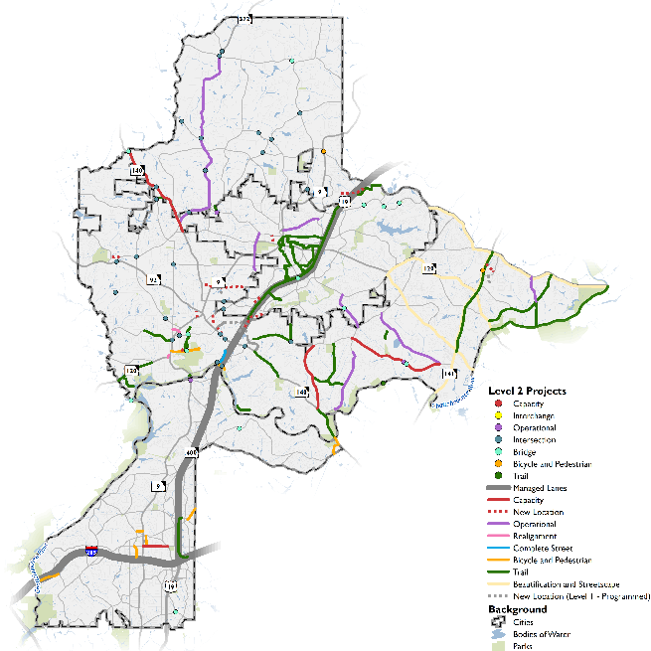
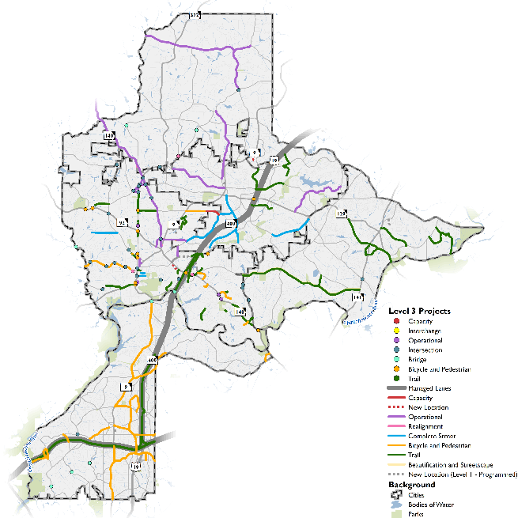
North Fulton – 3 Levels of Projects
Level 1
Level 2
Level 3
6

Slide 7
North Fulton – project types by City
*Does not include Major Mobility Investment Program (MMIP) Projects = $16.5 Billion
7

Slide 8
Level 1
Projects | City Cost* (in millions)
Capacity | $134.2
New Location | $74.7
Interchange | $15.5
Operational | $113.2
Intersection | $51.4
Complete Street | $4.2
Bicycle and Pedestrian | $51.6
Trail | $17.2
Projects and Programs | $462.0
*Projects that are sponsored by regional and/or statewide agencies are not shown on this map because City is not a direct sponsor.
8

Slide 9
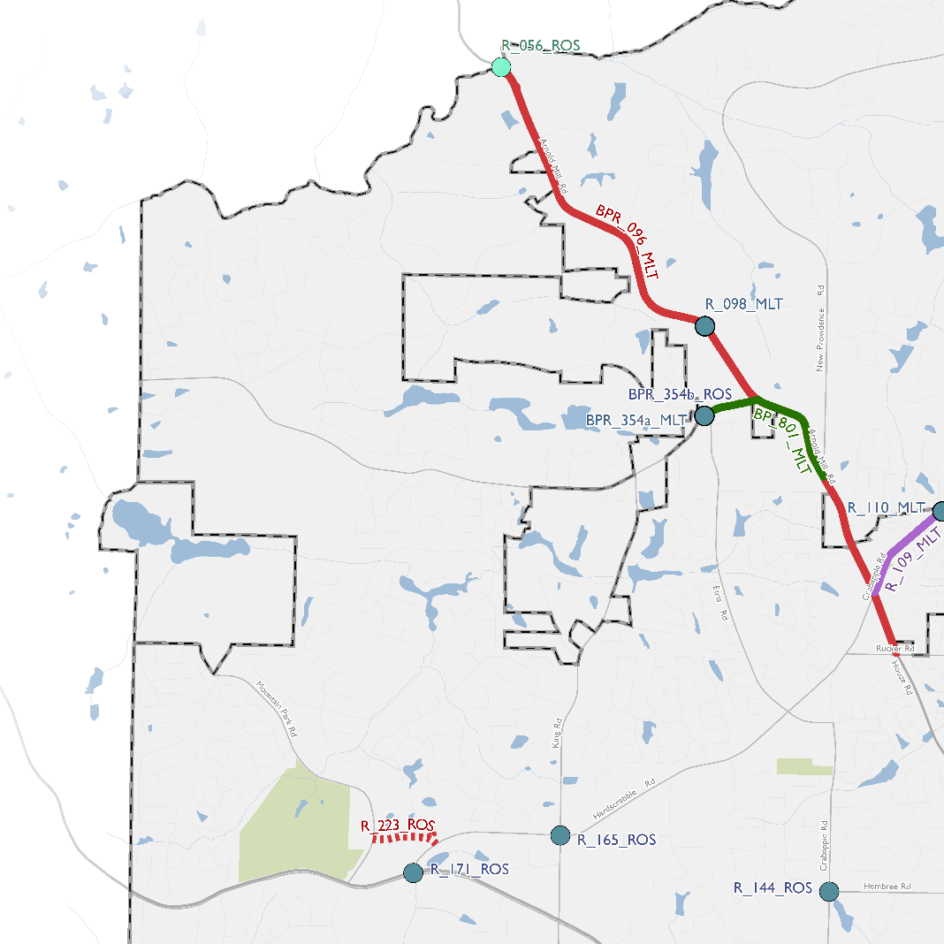
Level 2
Projects | City Cost (in millions)
Capacity | $48.1
New Location | $47.5
Operational | $33.2
Intersection | $19.5
Realignment | $0.7
Complete Street | $1.9
Bicycle and Pedestrian | $15.3
Trail | $63.5
Beautification and Streetscape | $5.0
Projects | $234.7
Programs | $89.0
Total | $323.7
9

Slide 10
Level 3
Projects | City Cost (in millions)
Capacity | $3.0
New Location | $13.0
Operational | $35.6
Intersection | $24.5
Realignment | $9.2
Complete Street | $27.5
Bicycle and Pedestrian | $53.1
Trail | $68.0
Projects | $233.9
Programs | $83.3
Total | $317.2
10

Slide 11
Next Steps
Adoption by North Fulton Cities
Mountain Park – February 26
Alpharetta – March 5 (Work Session), Council Meeting March/early April
Johns Creek – February 26 (Work Session), Council Meeting March TBD
Roswell – adopted in 2017
Sandy Springs – adopted on February 20, 2018
Milton – adopted on February 21, 2018
11

Slide 12
Mountain Park CITY COUNCIL MEETING
February 26, 2018

